Slide 1
Introduction to the IoT
Internet-of-Things (IOT)

Slide 2
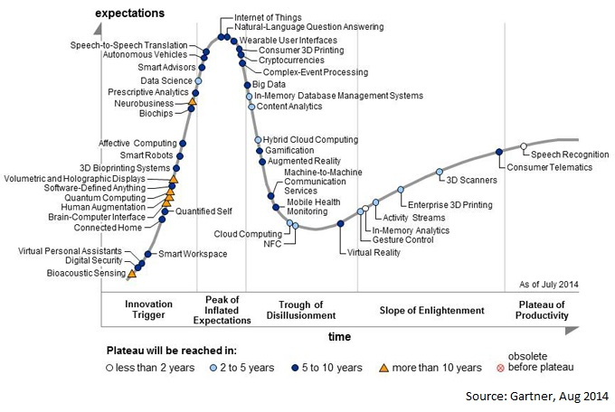
The IoT Hype (2015)

Slide 3
Hype vs. Fact
2011: NFC Payment, Internet TV
2012: BYOD, 3D Printing
2013: Wearable UI, Gamification, Consumer 3D printing
2014: NLP, IoT

Slide 4
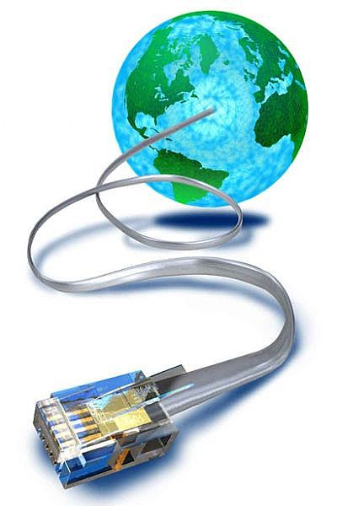
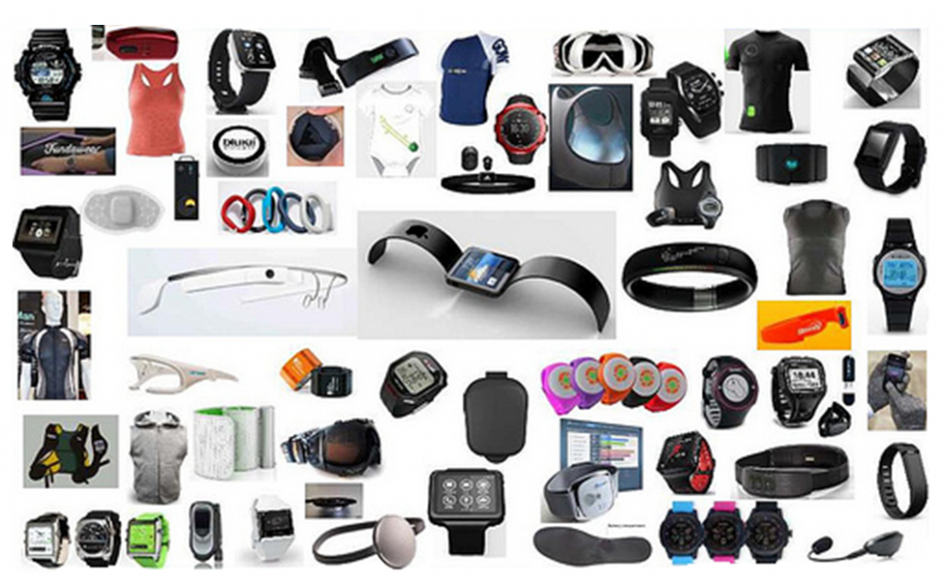
The IoT Concept

Slide 5
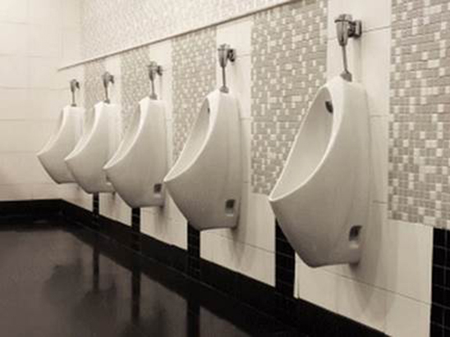
Example
Smart Restrooms —
Found in Heathrow’s Terminal 2, these smart restrooms have embedded sensors that track people’s movement and bathroom flow, and can alert maintenance crews if there’s a problem

Slide 6
Driving Forces of IoT
Sensor Technology – Tiny, Cheap, Variety
Cheap Miniature Computers
Low Power Connectivity
Capable Mobile Devices
Power of the Cloud

Slide 7
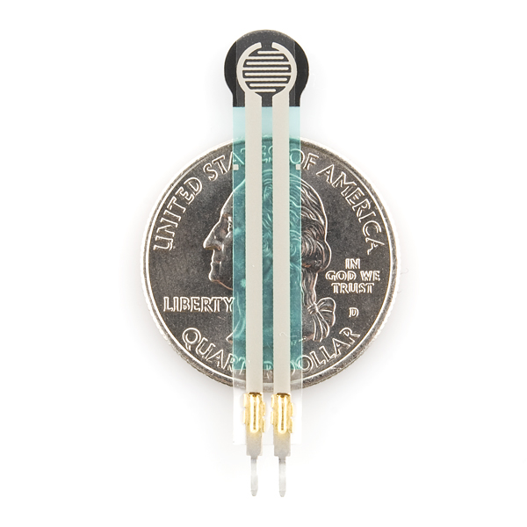
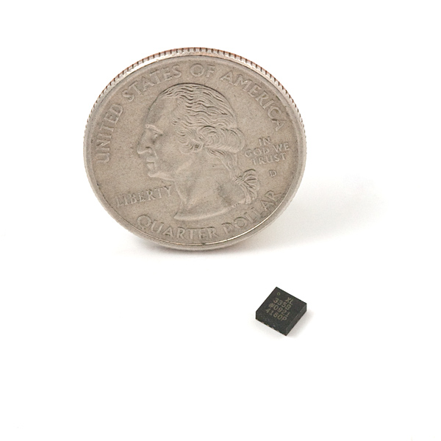
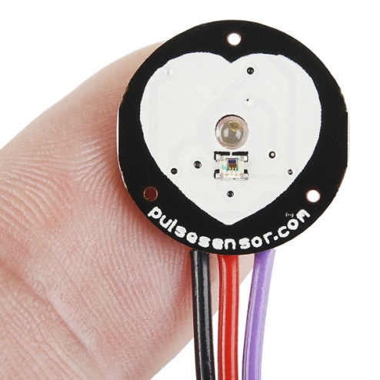
1. Sensor Technology
Accelerometer
(4mm diameter)
Force Sensor
(0.1N – 10N)
Pulse Sensor
$25
https://www.sparkfun.com/
https://www.adafruit.com/

Slide 8
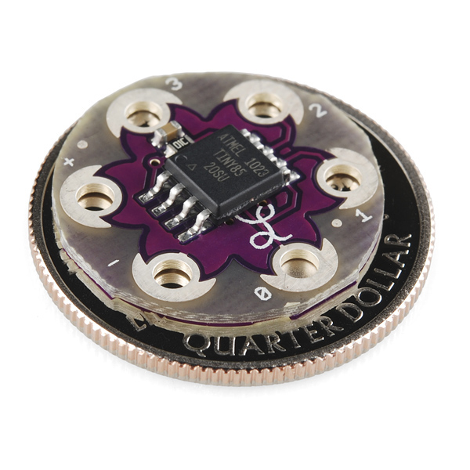
2. Cheap Mini Computers
Key Parameters
Flash: 8 Kbytes
Pin Count: 8
Max. Operating Freq: 20 MHz
CPU: 8-bit AVR
Max I/O Pins: 6
Ext Interrupts: 6
SPI: 1
I2C: 1
Lily Tiny
http://www.atmel.com/devices/ATTINY85.aspx?tab=parameters

Slide 9
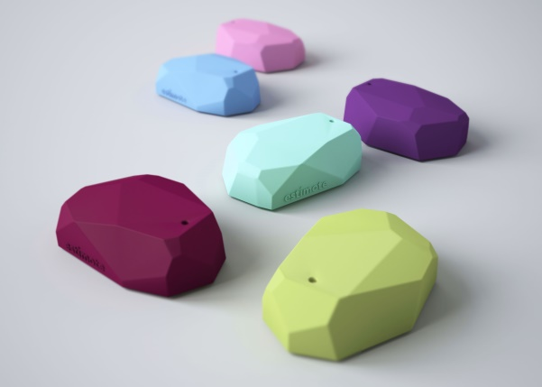
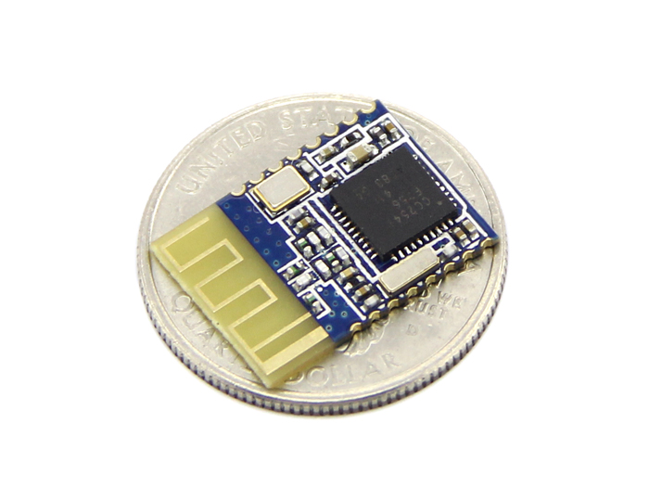
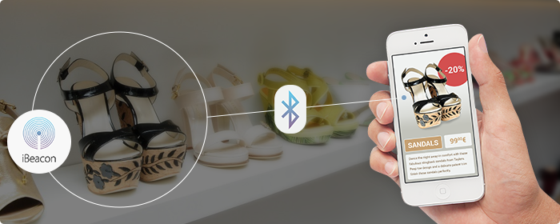
3. Low Power Connectivity
Bluetooth Smart (4.0)
(Up to 2 years with a single
Coin-cell battery)

Slide 10
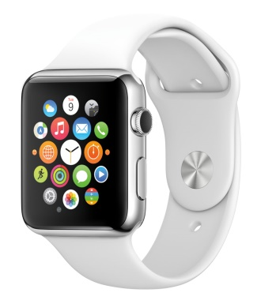
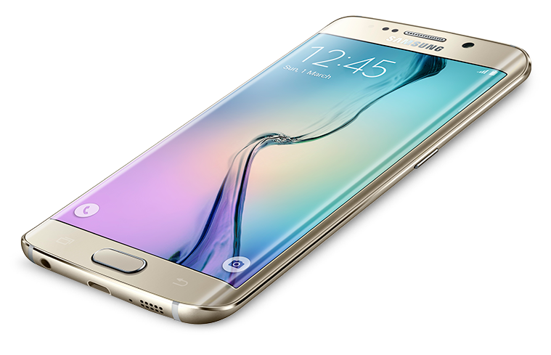
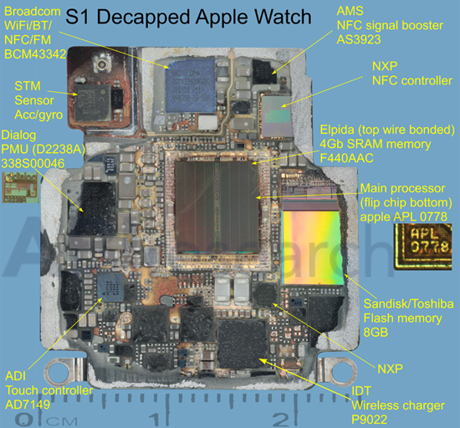
4. Capable Mobile Devices
Quad Core 1.5 GHz
128 GB Internal Memory
3 GB RAM
16 MP Camera
2160p@30fps video
WiFI, GPS, BLE

Slide 11
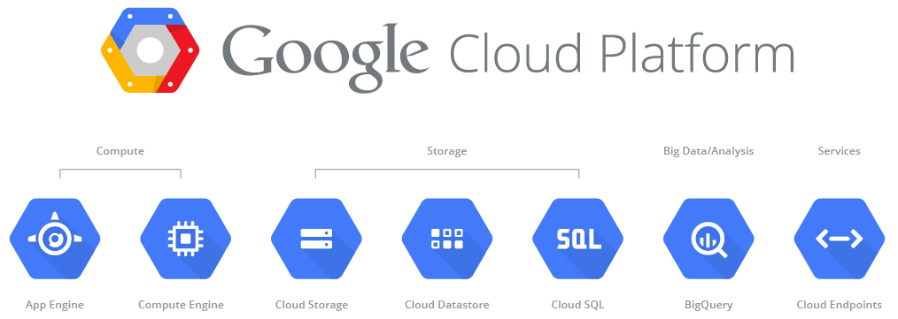

5. Power of the Cloud

Slide 12
CSUF IoT Applications?
Notes:
Parking (real-time parking availability)
EV Charging system
Chargepoint lets you see and reserve spots before you get there
ifullerton app
Bluetooth

Slide 13
IoT Applications
Google Nest
MyShake Earthquake warning app
Industrial IoT
Vehicle-to-Vehicle Communication
Intelligent lighting
Smart greenhouse
Road repair
Real-time traffic monitoring
Smart public restrooms
Smart electricity meters
USC Microgrid
Notes:
Parking (real-time parking availability)
EV Charging system
Chargepoint lets you see and reserve spots before you get there
ifullerton app
Bluetooth

Slide 14
Classwork
Pick the topic corresponding to your breakout room number
Read the corresponding webpage and do a quick research on it on the Internet
How do the 5 “driving forces” apply to this application
Present for about 2 minutes to the class

Slide 15
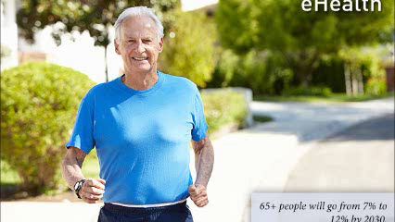
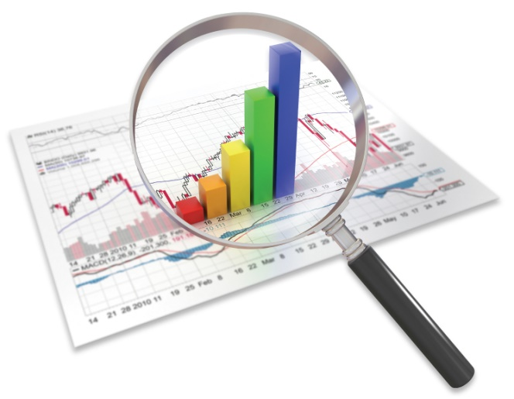
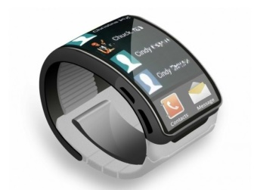
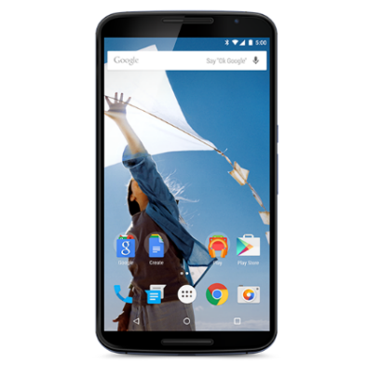
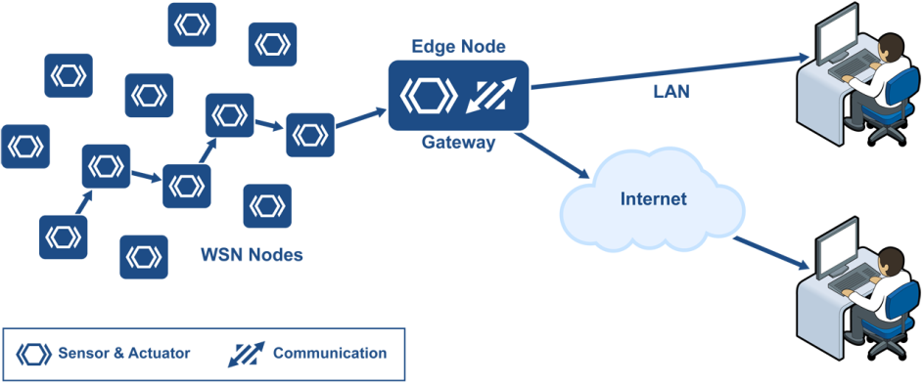
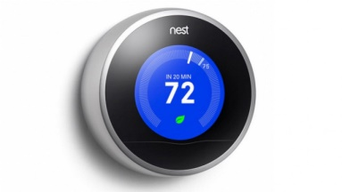
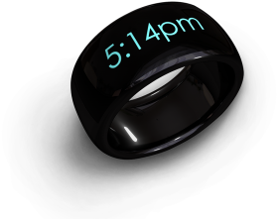
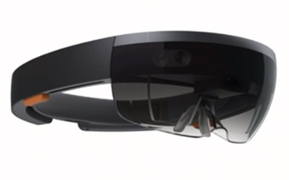


A-B-C-D of IoT
Applications
Big Data Analytics
Connectivity and Communication
Devices – that are smart!
Photos – Libelium, Google Image Search

Slide 16
Big Data Analytics
Similarity
Clustering
Streaming Data
Map-Reduce
Dimension Reduction

Slide 17
Connectivity
Wireless Sensor Networks
IPv6 and 6LowPAN
Bluetooth LE and ZigBee
WiFi and LTE

Slide 18
Devices and Platforms
Mobile Systems
Sensor Systems
Wearables
Energy Harvesting
Security and Privacy

